Slide 1
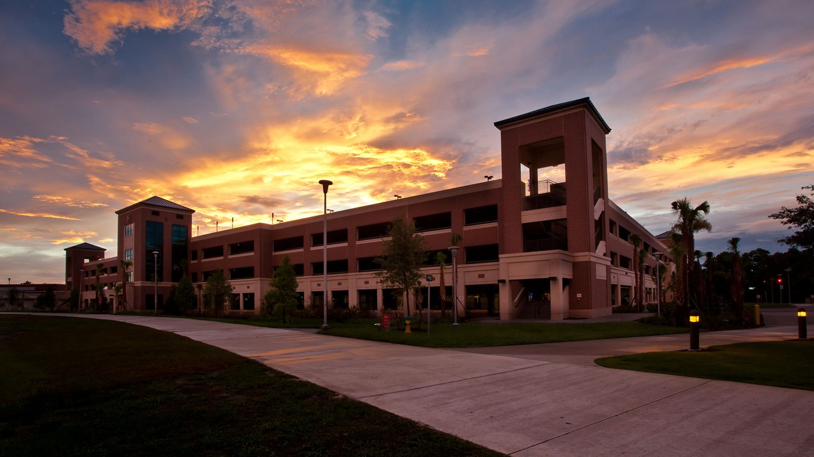
Smart Parking System
Oscar Acuna | Jordan Johnson
M. Ridwan | Kyle Carpenter
Group B

Slide 2
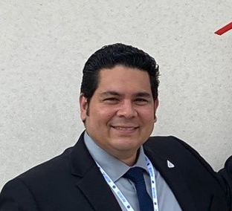


Oscar Acuna
Computer Engineering
oacuna@knights.ucf.edu
Jordan Johnson
Electrical Engineering
jordan614407@knights.ucf.edu
M. Ridwan
Computer Engineering
mridwan@knights.ucf.edu
Kyle Carpenter
Computer Engineering
kylecarpenter@knights.ucf.edu

Slide 3
Motivation
Jordan Johnson
With heavy traffic flow, UCF’s parking garages become congested and create a variety of problems
Not enough information about the parking situation inside of a garage with signs outside of them indicating “open” or “full”, and UCF’s parking garage app showing a % occupancy
Students tend to drive faster when they are running late and are struggling to find a parking spot which creates an unsafe environment
Designing a modern parking system will create a safer environment inside garages and help students and faculty be on time to classes

Slide 4
Goals and Objectives
Kyle Carpenter
Use Computer Vision to detect cars passing through region
Use LED displays to communicate total open parking spaces in region of garage
Develop the system for low power consumption (Not high priority since not battery driven)
Utilize ethernet for communication between camera, server, and sign display

Slide 5
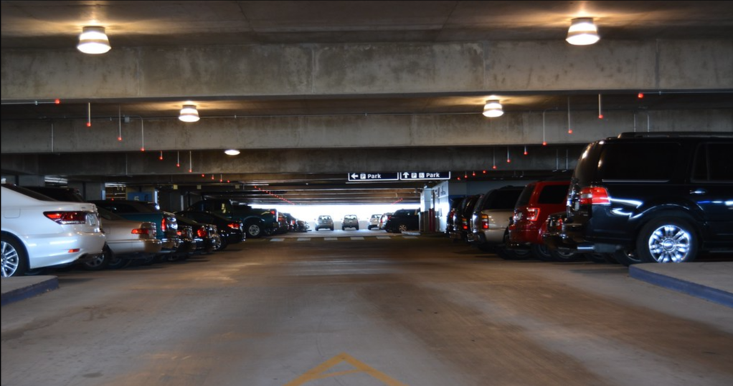
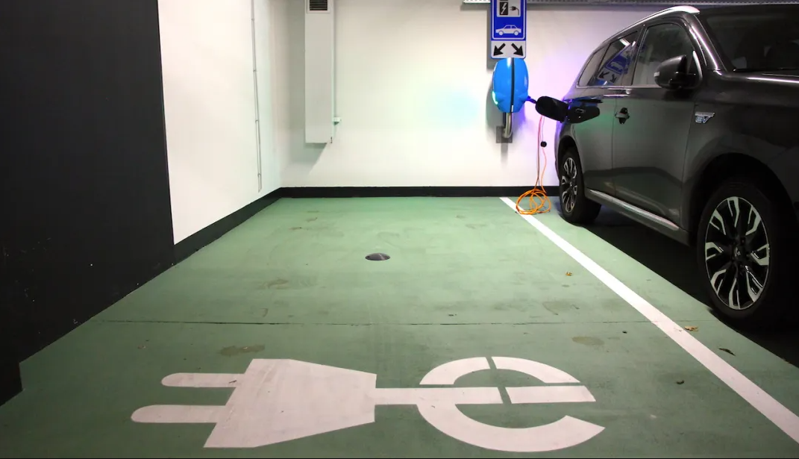
Existing Systems
M Ridwan
Indect
Single Space Ultrasonic sensors
Surface Mounted Sensor
ParkEagle
Ultra-low-power smart parking sensors

Slide 6
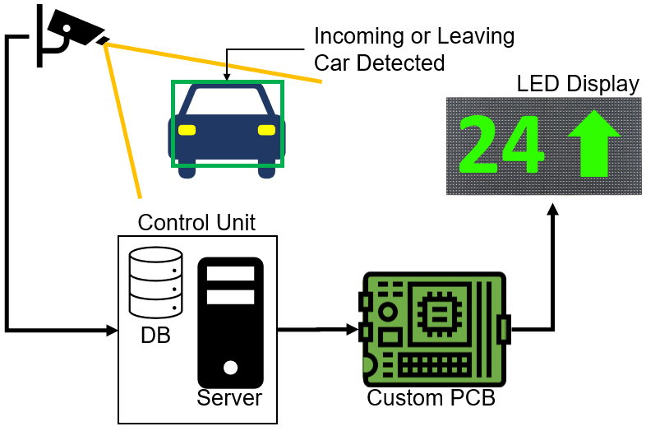
Project Description and Overview
Kyle Carpenter
Parking garage regional info system
Through computer vision, detect vehicles and transmit info to display
GUI application shows entire parking spot availability breakdown

Slide 7
Specifications and Requirements
Component | Parameter | Specification
System | Max Update Delay | 10 sec
LED Display | Min Brightness | 1,000 nits
Control Unit | Min Scalability | 100 camera/PCB assemblies
Camera | Accuracy | 95% accurate detecting vehicles entering or leaving
Kyle Carpenter

Slide 8
Division of Labor
 | Oscar | Ridwan | Jordan | Kyle
PCB Design |  |  | ✔ | ✔
Camera Programming | ✔ | ✔ | ✔
MCU Ethernet Programming |  |  |  | ✔
MCU LED Matrix Driver Programming | ✔ |  |  | ✔
Java Background Service and GUI Programming | ✔
Database Programming | ✔ | ✔
Kyle Carpenter
✔ Primary Responsibility | ✔ Secondary Responsibility

Slide 9
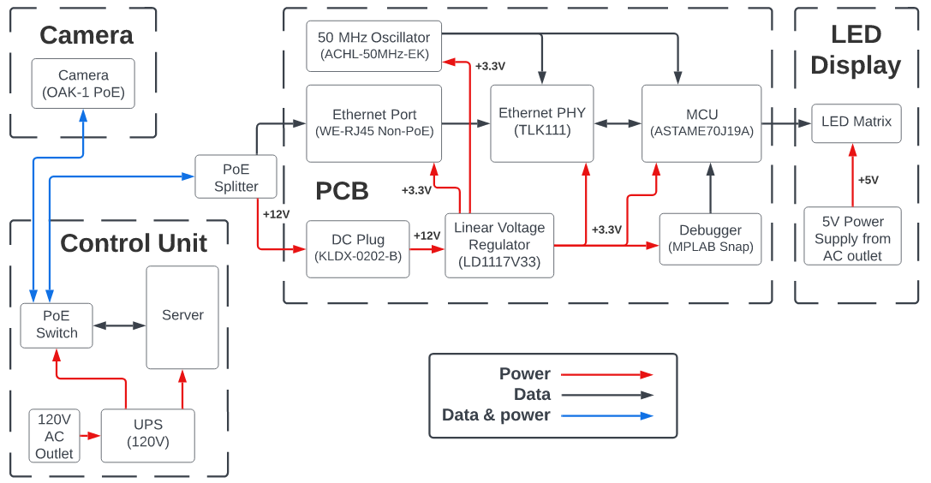
Overall System - Hardware Block Diagram
M Ridwan

Slide 10
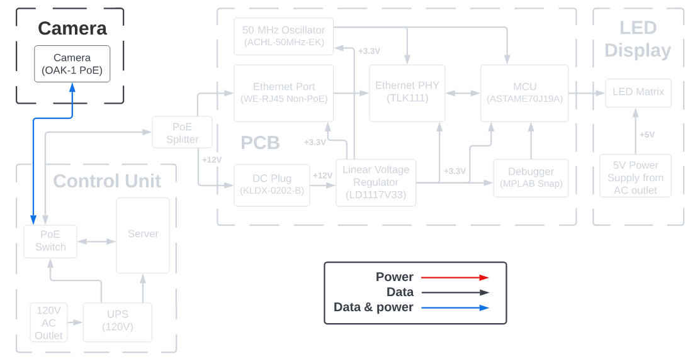
Camera - Hardware Block Diagram
M Ridwan

Slide 11
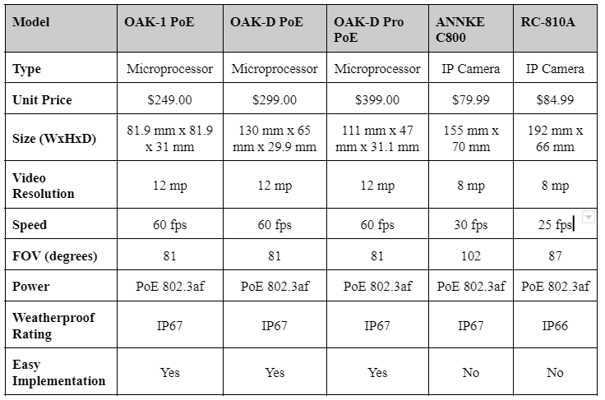
Camera - Considerations
M Ridwan
Notes:
Something to note: alleviates processing needed from server since it only is receiving data on car count, no image processing

Slide 12
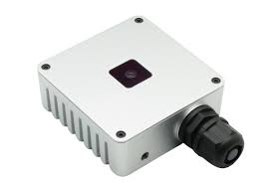
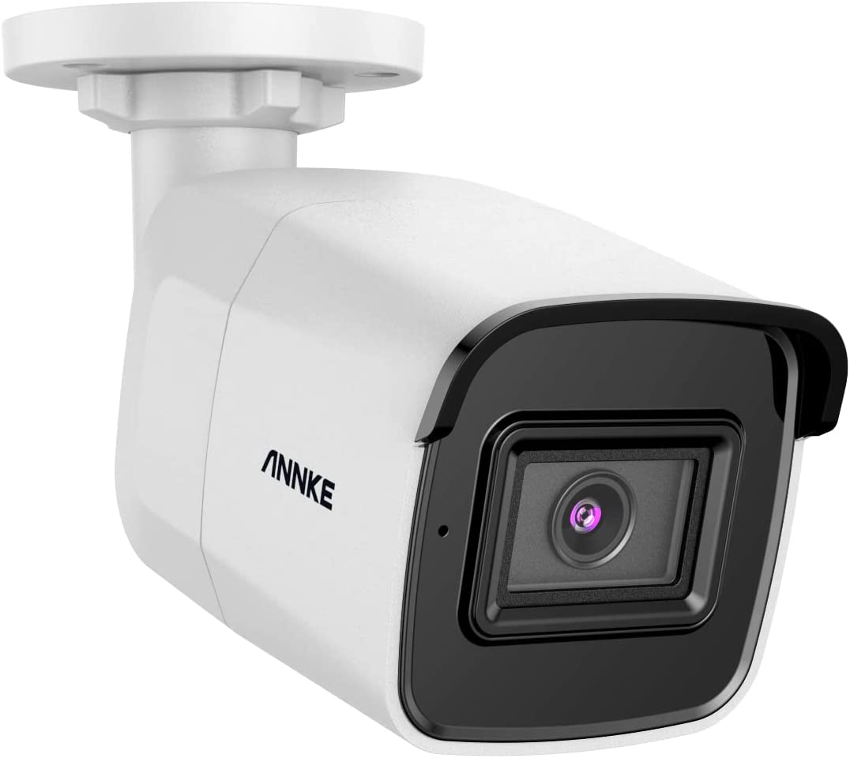
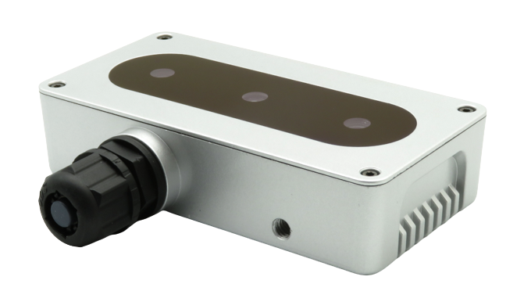
Camera - Hardware
ANNKE C800
( No Onboard AI computation )
OAK-D-PoE
( High Price Range and a lot of extra unused features for project )
M Ridwan
Single RGB image sensor camera
Powered with POE
Embedded microprocessor for onboard AI computation
H.264, H.265, and MJPEG encoding
1,000 Mbps transmission speed

Slide 13
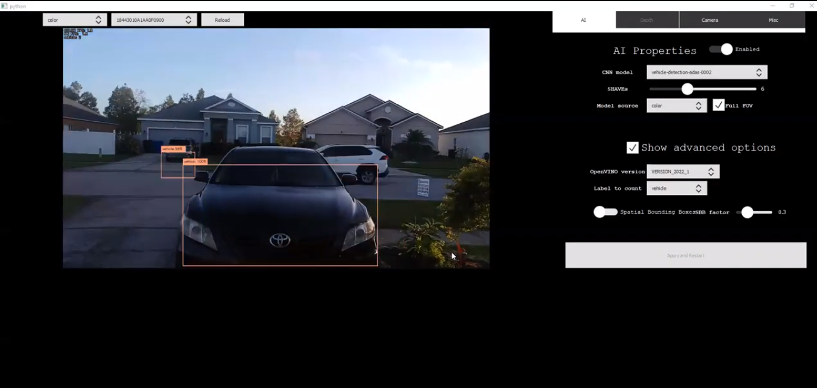
Camera - Computer Vision
DepthAi-Demo
vehicle-detection-adas-0002
M Ridwan
Notes:
Something to note: alleviates processing needed from server since it only is receiving data on car count, no image processing

Slide 14
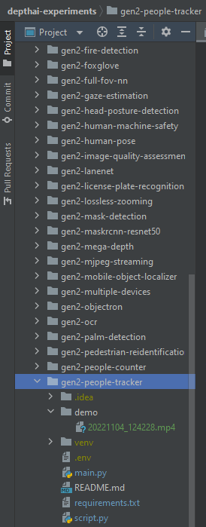
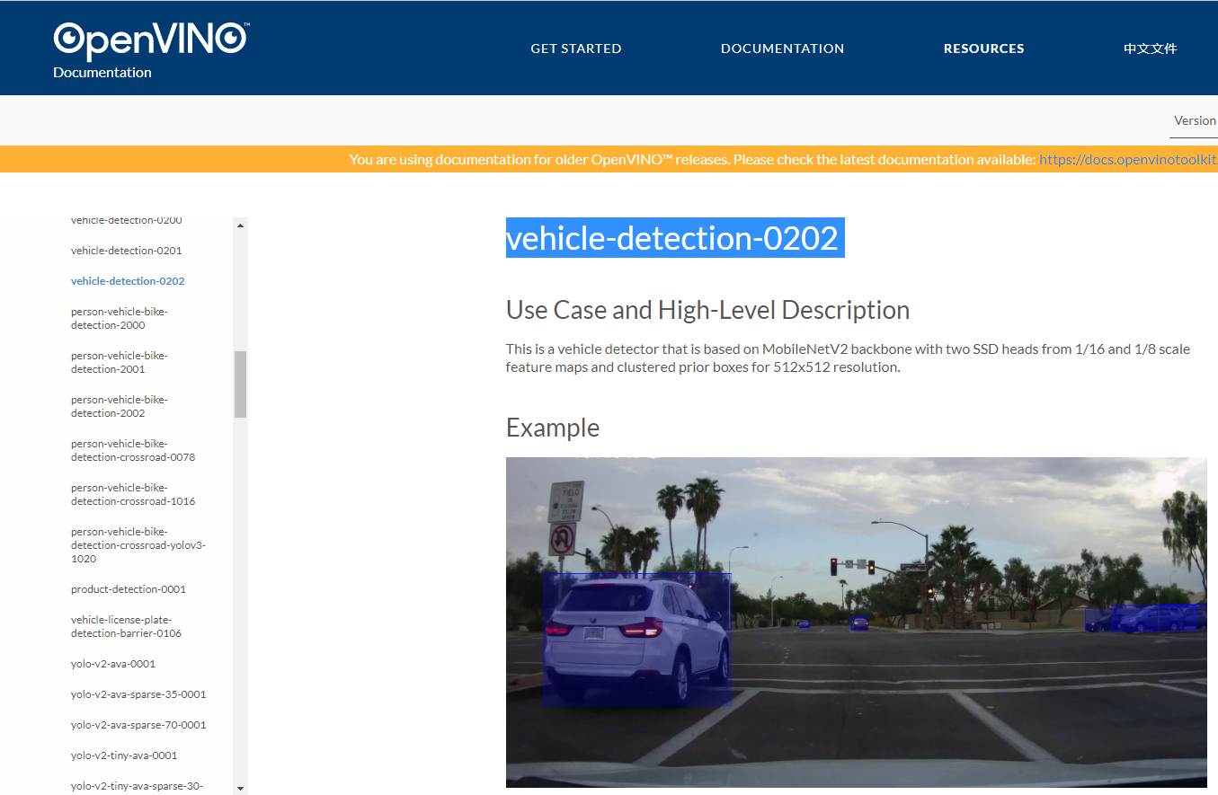
Camera - Computer Vision
DepthAi-Experiments
gen2-people-tracker
M Ridwan
OpenVINO
vehicle-detection-0202
Notes:
Something to note: alleviates processing needed from server since it only is receiving data on car count, no image processing

Slide 15
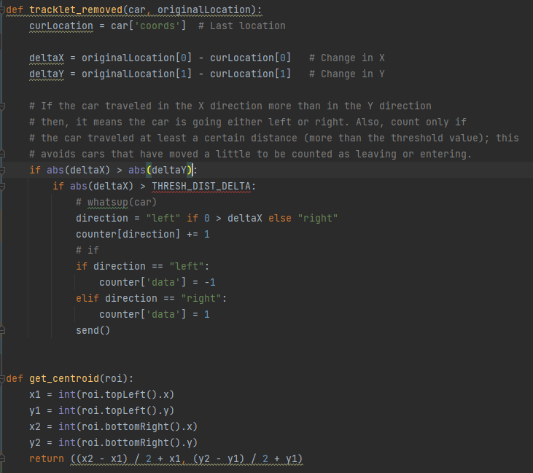
Camera - Computer Vision
vehicle-detection-0202
Outputs:
image_id - ID of the image in the batch
label - predicted class ID (0 - vehicle)
conf - confidence for the predicted class
(x_min, y_min) - coordinates of the top left bounding box corner
(x_max, y_max) - coordinates of the bottom right bounding box corner.
M Ridwan
Detecting Directions:
Notes:
Something to note: alleviates processing needed from server since it only is receiving data on car count, no image processing

Slide 16
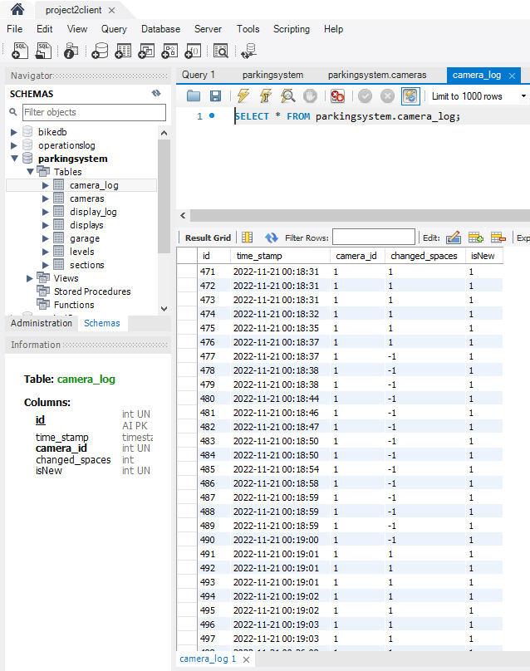
Camera - Computer Vision
Database
MySQL
Entering : “-1”
Leaving : “+1”
M Ridwan
Notes:
Something to note: alleviates processing needed from server since it only is receiving data on car count, no image processing

Slide 17
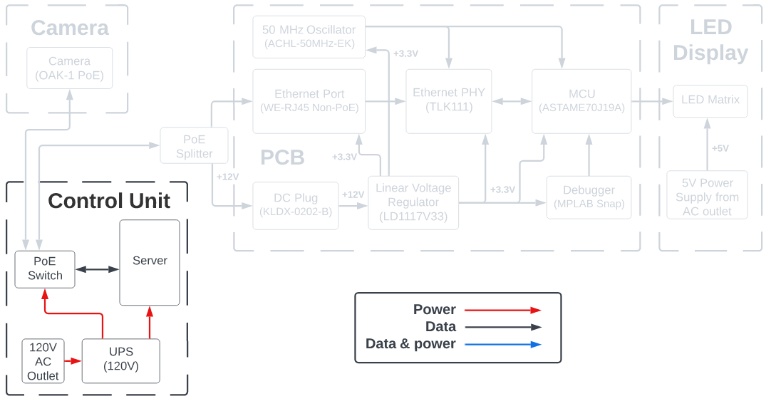
Control Unit - Hardware Block Diagram
Oscar Acuna
Notes:
Let’s talk about the control Unit:
The control unit is what seats between the camera and the PCB
It has a server which tracks the number of spaces available in the entire garage
An ethernet switch through which the Camera and the PCB communicates.
An a battery backup to power all these components.

Slide 18
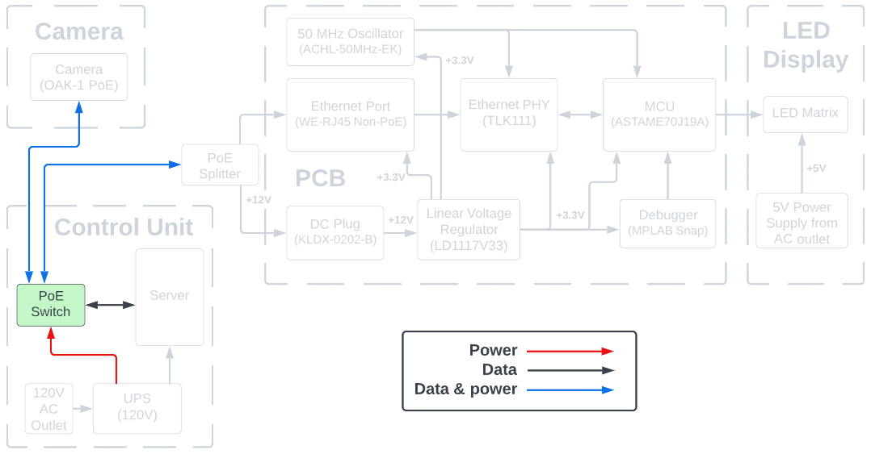
Control Unit - PoE Switch
Oscar Acuna
Notes:
Let’s talk about the Ethernet Switch first.
To power the Cameras and the PCB, we thought that using Power over Ethernet would be more cost effective than having traditional electric outlets throughout the garage.
Power over Ethernet (PoE) is a technology that allow us to inject or transmit electricity into the same cable that transmit the data.

Slide 19
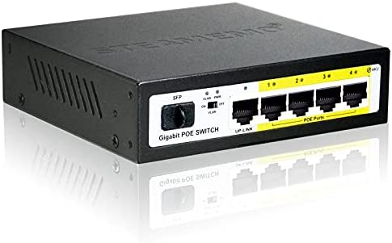
Control Unit - PoE Switch (Continued)
5-port PoE Ethernet Switch
Power over Ethernet (PoE)
PoE 802.3af
12.95 watts
Up to 350 mA
PoE switch comparison
Oscar Acuna
Brand | Model | No. of PoE ports | Price
Netgear | GS305P-100NAS | 4 PoE+ ports (Type 2) | $49.99
TP-Link | TL-SG1005P V2 | 4 PoE ports (Type 1) | $44.99
STEAMEMO | GPOE204 | 4 PoE+ ports (Type 2) | $33.99
Notes:
Deploying our parking system to an entire garage would require a switch with many more ports.
But, a small 5-port switch will be enough for our proof of concept.
The selected camera required PoE Type 1 (802.3af), so we searched online for this type of switch.
And we found several options as shown in the table.
Some of them are, Type 2 PoE switches, but they are backward compatible with Type 1.
At the end, we selected the most cost effective one for $33.99

Slide 20
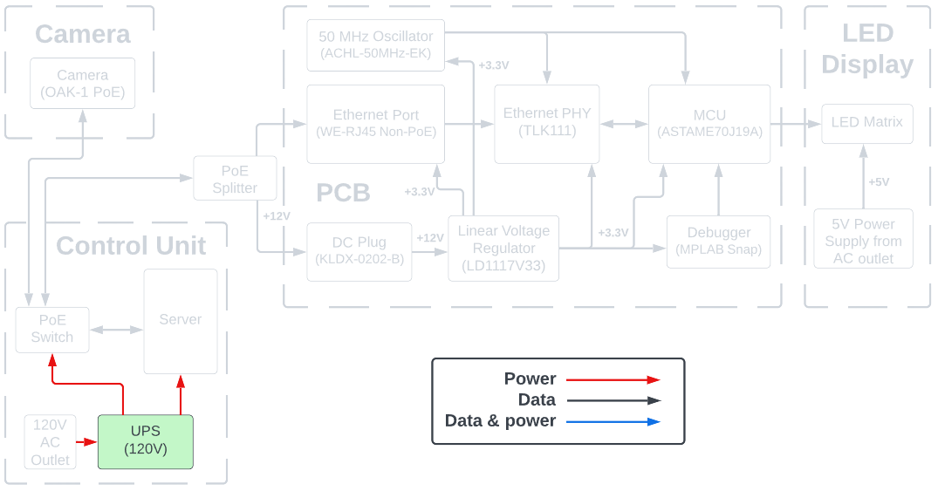
Control Unit - UPS (Battery Backup)
Oscar Acuna
Notes:
Let’s talk about the UPS or Battery Backup.

Slide 21
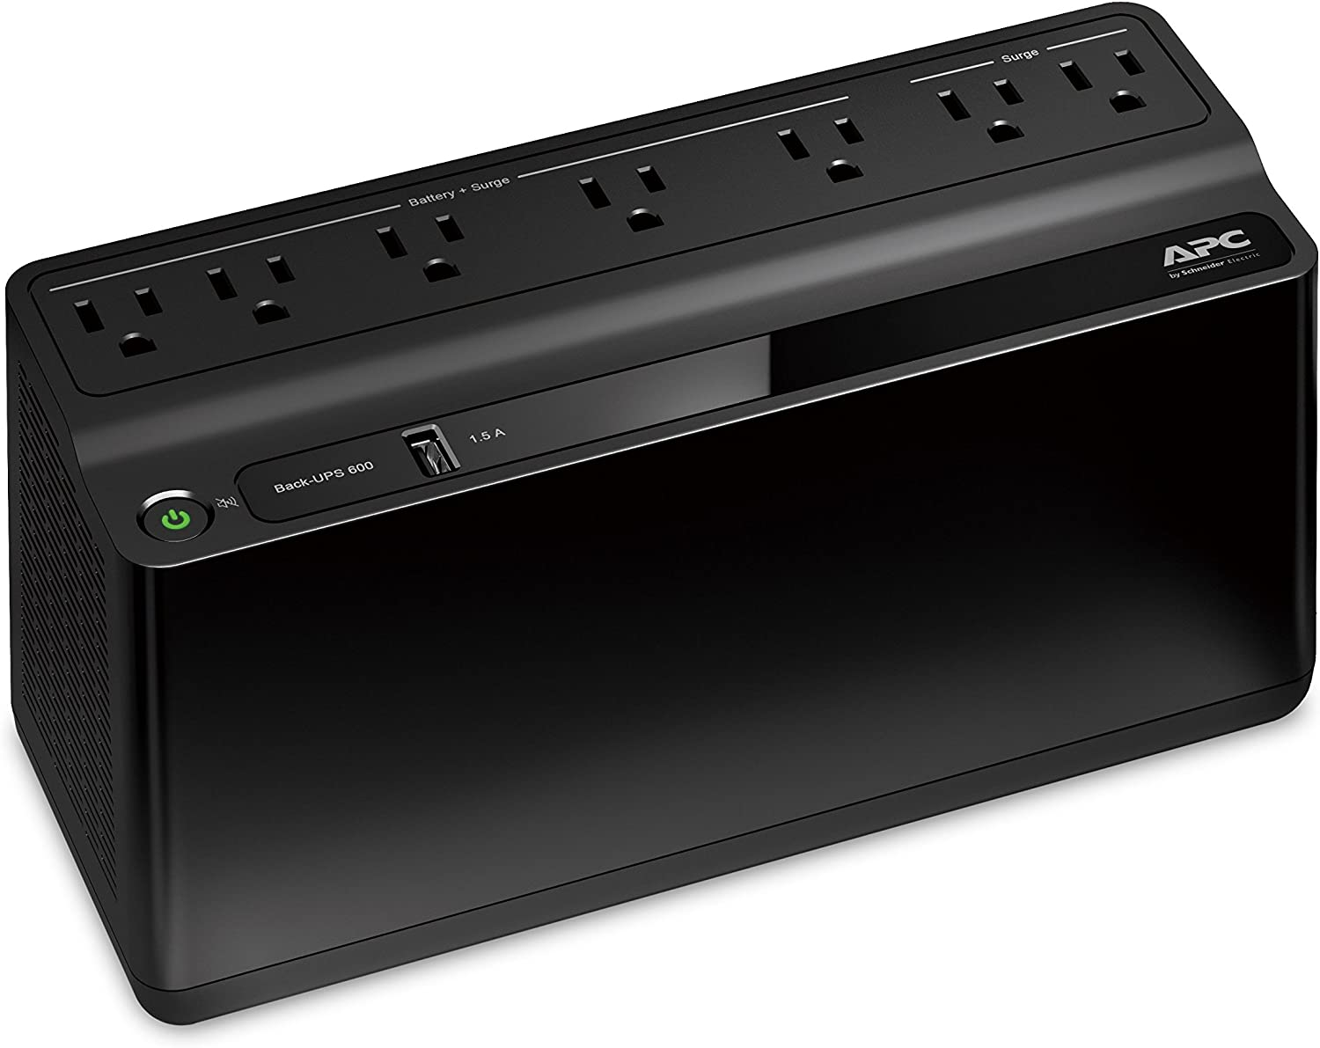
Control Unit - UPS (Battery Backup)
Power requirement calculation:
52 watts (PoE Switch Max Power Consumption)
36 watts (Server Max Power Consumption)
Total: 88 Watts (Up to two cameras and 2 PCB)
Uninterruptible Power Supply (UPS)
Battery Backup
~23 mins at 100 watts
Brand: APC
$75.99
Oscar Acuna
Notes:
For our project, we wanted a UPS that could keep the system running for at least 10 minutes, capable of keeping the camera, switch, and the server while doing our test and demonstrations.
We calculated that between the PoE switch and the server, we needed about 88 Watts.
We found this APC brand UPS, but at the end, we didn’t because one our our team members had one UPS.

Slide 22
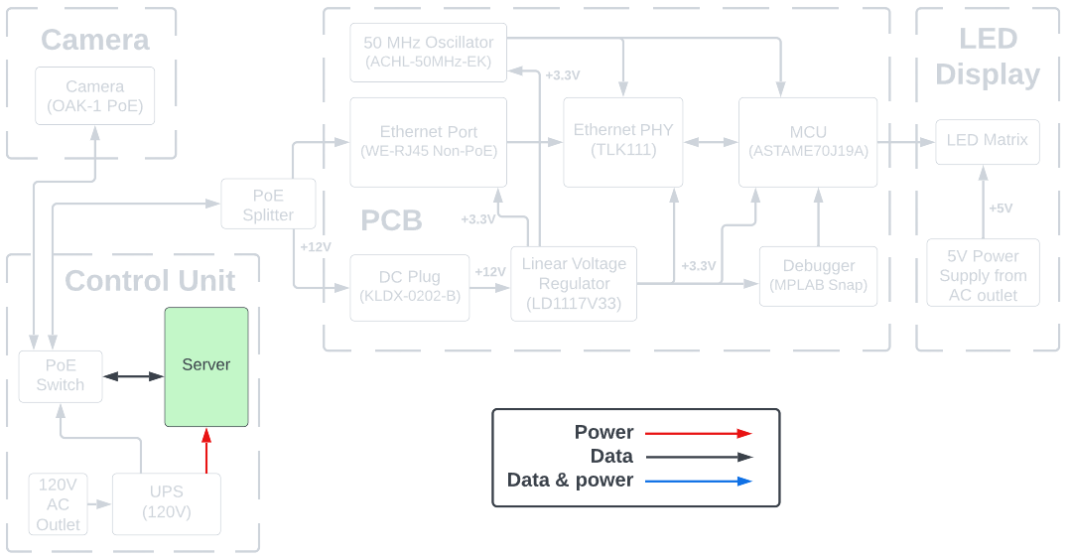
Control Unit - Server
Oscar Acuna
Notes:
Now let’s talk about the server:
We need three things for our parking system:
A place where to store the data captured by the camera.
A device to relay to the data from the cameras to the LED signs
A program to interact with the parking system, to configure it, display live data, keep track of available spaces, etc.
In other words, we needed a server that can support a database, that has an ethernet port, enough CPU and RAM capacity to run a custom program.

Slide 23
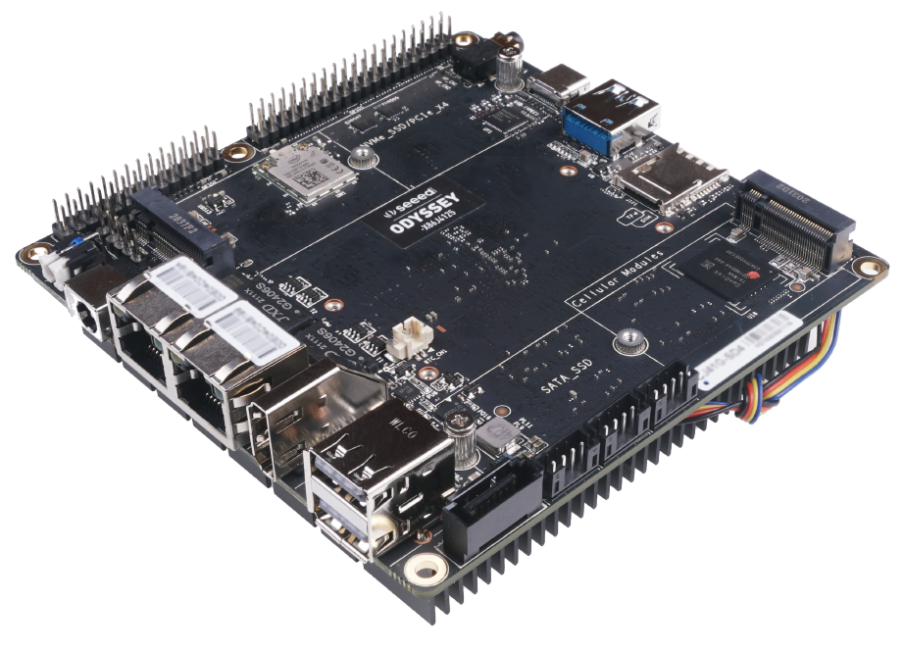
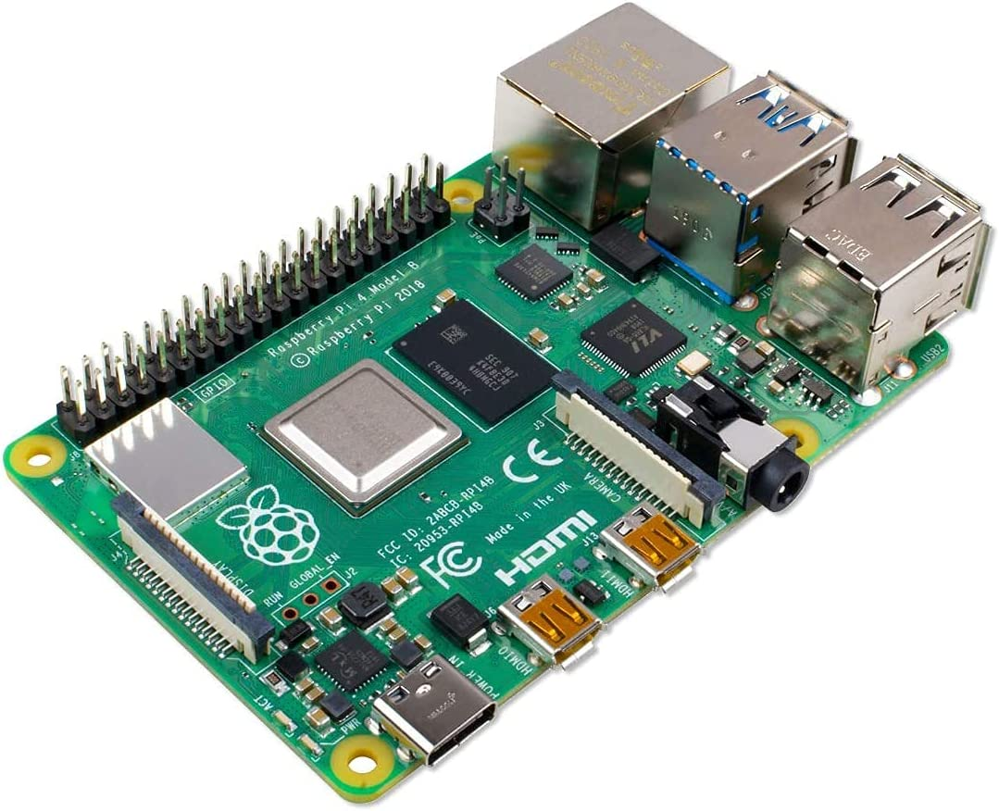
Control Unit - Server Hardware
Odyssey
Server Option Comparison
Raspberry Pi
Oscar Acuna
Brand | Model | CPU | RAM | Price
Seeed | Odyssey X86J4125864 | 2.0GHz 4C Intel Celeron J4125 | 8GB LPDDR4 | $238.00
Raspberry Pi | 4 Model B | 1.5GHz 4C Broadcom (ARM v8) | 8GB LPDDR4 | $184.95 (CanaKit)
UDOO | X86 II Advanced Plus | 1.6GHz 4C Intel Celeron N3160 | 4GB DDR3L | $214.00
Notes:
Now, the most cost effective computers are those that come with built-in CPU and Memory RAM, and usually have no expansion slot such as the Raspberry Pi, or those shown in the table. These boards are called Single-Board Computers and there are many options out there, although not all of them were available due to the chips availability.
Initially we had selected the Odyssey board because we could install Windows because we had already started developing the software for a Windows machine.
However, this board was on backorder, and we didn’t want to risk not getting on time.
The other board capable of running Windows, the X86 Advanced Plus was not available either; therefore, we chose Raspberry Pi.

Slide 24
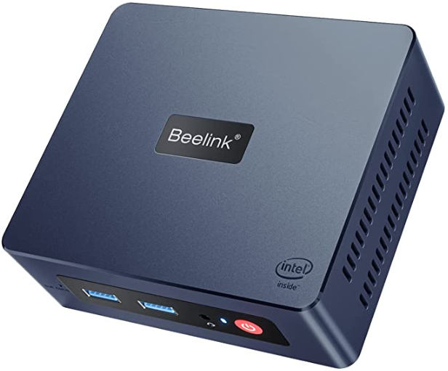
Control Unit - Server Hardware
Odyssey
(On Backorder)
Raspberry Pi
(ARM Architecture. Issues running our Java program and database)
Oscar Acuna
Beelink Mini PC (Model: Mini S)
Intel 11th Gen Processor (N5095)
Up to 2.9GHz, 4 cores.
Windows 11 Pro
8GB DDR4
Notes:
However, we started having issues with our JAVA program running on the raspberry pi, running the database, and overall configuring the raspberry pi, and after spending a day and half on this board, we found yet another solution and with we switched to this Beelink Mini PC that has an Intel processor, capable of running Windows, onto where our Java program and database run without issues.

Slide 25


Control Unit - Server Software
Oscar Acuna
Java for our GUI
Background Service Program
MySQL Database
Notes:
The programming language we used to developed the server software was Java, and MySQL for the database. We chose these because I had some experience working with these two in other school projects in previous courses.

Slide 26
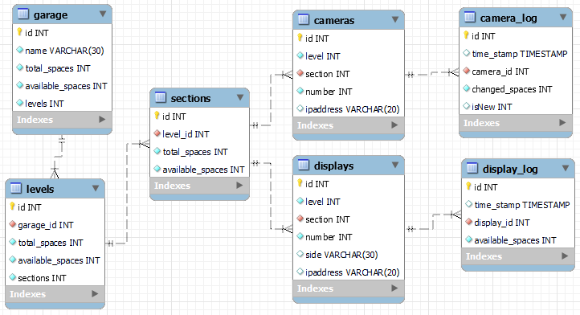
Control Unit - Server Software
MySQL Database
Oscar Acuna
Notes:
All the parking system’s data is stored in a database. The database was created using MySQL Workbench. Here are the tables used by our parking system:
The garage is divided in Levels,
Each level is divided in section
And each section can have cameras and LED displays.
And this is the table where the camera records whenever it detects car entering or leaving a parking area.

Slide 27
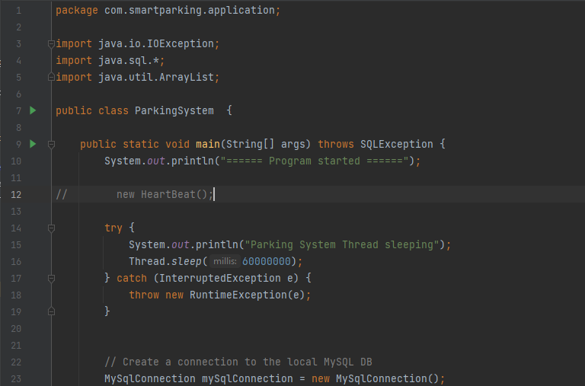
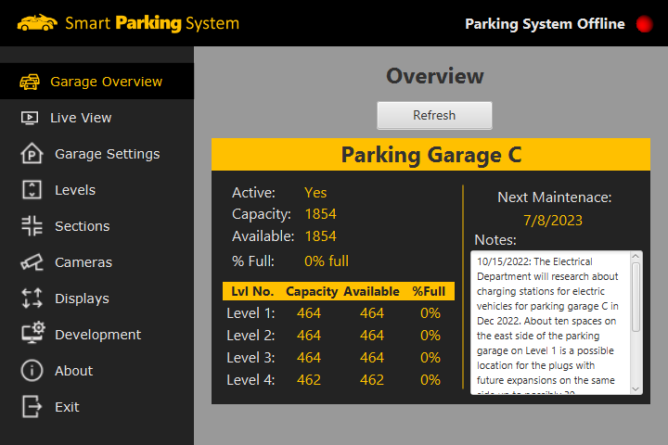
Control Unit - Server Software
Two JAVA Programs
Oscar Acuna
The background service program
The Java GUI
Notes:
In addition to hosting the database, the server also runs two JAVA programs.
The background service, which is the program that is doing all the heavy lifting of checking for new updates from the camera, calculating the changes on the number of spaces, and updating the LED displays.
The 2nd program program is the user interface or GUI, which is used to monitor the parking garage system and make changes to the system like adding a camera or a new LED sign.

Slide 28
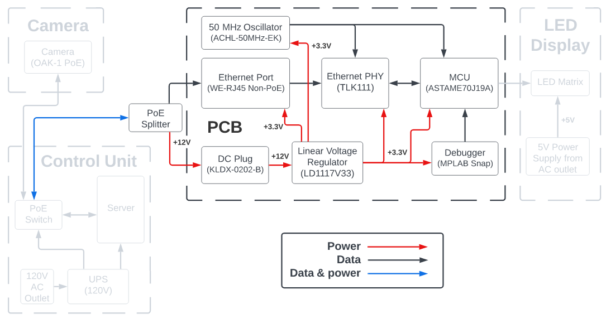
PCB - Hardware Block Diagram
Jordan Johnson

Slide 29
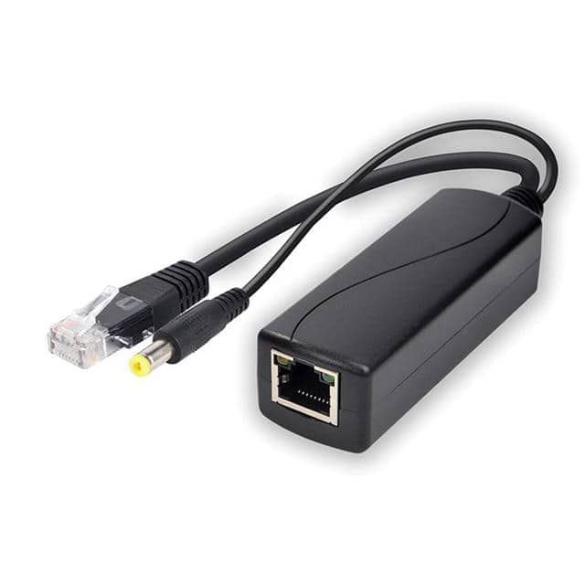
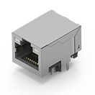
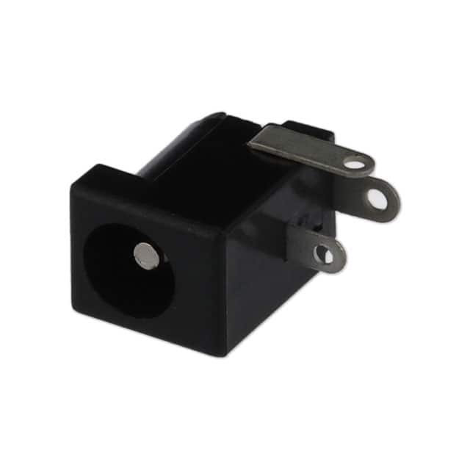
PCB Components
Power over Ethernet (PoE) Splitter
Allows power and data to be on two separate connections
$14.54
Ethernet Port
Receives ethernet connection from PoE splitter
Interfaced with Ethernet PHY
$6.20
DC Plug
Receives 5V power connection from PoE splitter
$0.74
Jordan Johnson

Slide 30
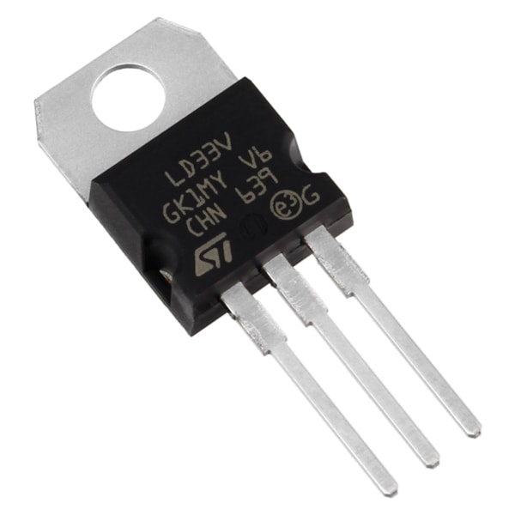
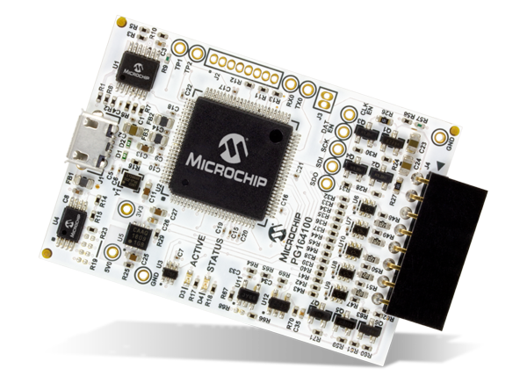
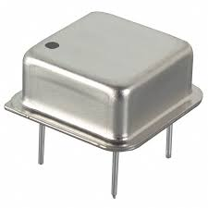
PCB Components
Voltage Regulator
Regulates +5V input to +3.3V
$1.32
MPLAB Snap
Includes SWD debug interface for communication with ATSAME70J19A, TLK111, and LED Matrix
$34.09
50 MHz Oscillator
Clock signal for TLK111 and ATSAME70J19A
Signal is fed into TLK111 which generates a reference clock signal for the the ATSAME70J19A
$2.61
Jordan Johnson

Slide 31
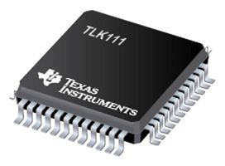
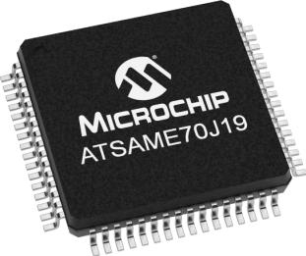
PCB Components
TLK111
48-LQFP
Controls status LEDs on ethernet port
Communicates with Media Access Control (MAC) block on MCU
Allows for interface between ethernet port and MCU
$11.34
ATSAME70J19A
64-LQFP
Includes MAC block for ethernet communication
Includes 44 GPIO pins for communication with LED Matrix
Serial Wire Debugging
$12.63
Jordan Johnson

Slide 32
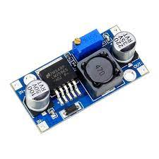
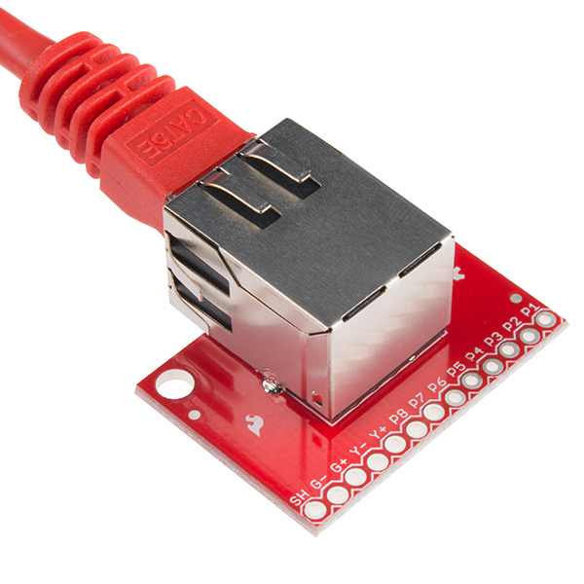
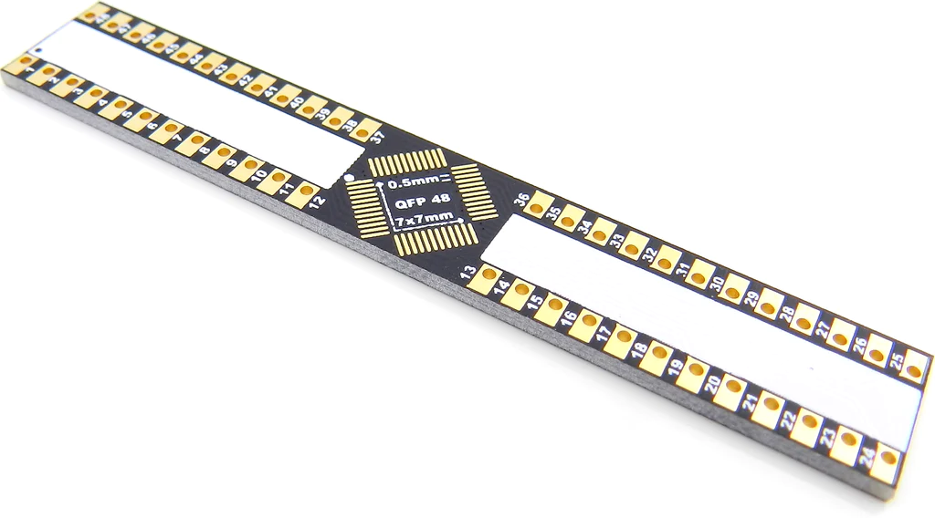
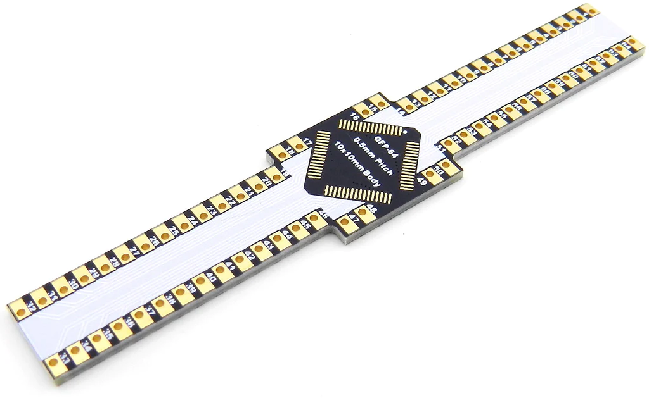
Breadboard Components
Adjustable Buck Converter
DC to DC Buck Converter used for prototyping purposes
$10.69 (Pack of 6)
RJ45 MagJack Breakout
RJ45 Breakout Board with integrated magnetics for easy prototyping with Ethernet PHY
$6.95
LQFP-64 & LQFP-48 Breakout Boards
Adapter for microchip pins to breadboard
$9.95 & $6.95
Jordan Johnson

Slide 33
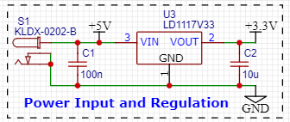
PCB Schematic (Power Input & Regulation)
+5V input from Power over Ethernet Splitter into DC Barrel Jack
LD1117V33 regulates this +5V input to +3.3V
Jordan Johnson

Slide 34
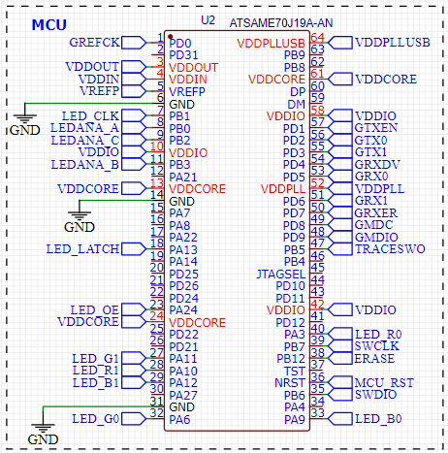
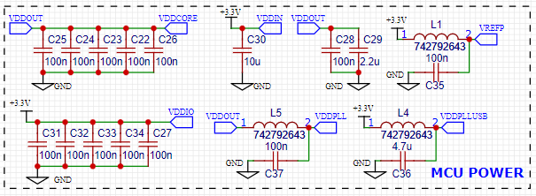
PCB Schematic (MCU)
Includes connections for:
Serial Wire Debugging (SWD)
LED Sign
Reduced Media Independent Interface (RMII) for communication with Ethernet PHY
Single power supply input
Makes use of internal voltage regulator for pins that don’t receive +3.3V
Jordan Johnson

Slide 35
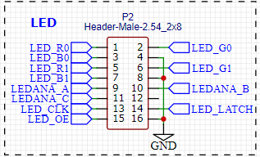
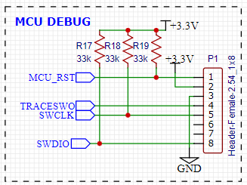
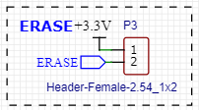
PCB Schematic (MCU Continued)
PCB includes one male and two female pin headers
LED Header (2x8 Male)
Uses 12 GPIO pins on the MCU to communicate with the LED Matrix
MCU Debug Header (1x8 Female)
Uses SWD pins on the MCU to connect with the MPLAB Snap Debugger
Erase Header (1x2 Female)
Needed for any situation where we need to erase the firmware on our device
Jordan Johnson

Slide 36
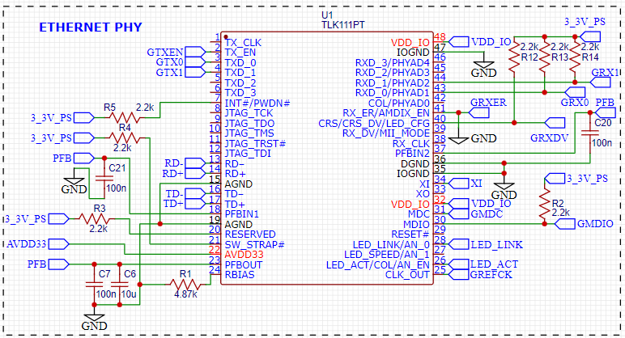
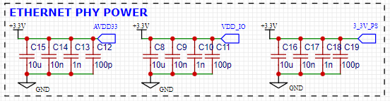
PCB Schematic (PHY)
Includes connections for:
Ethernet Port
Reduced Media Independent Interface (RMII) for communication with MCU Media Access Control (MAC) block
Single power supply input
Makes use of internal voltage regulator for pins that don’t receive +3.3V
External 50 MHz Oscillator
Jordan Johnson

Slide 37
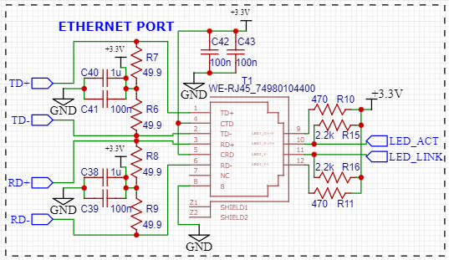

PCB Schematic (PHY Continued)
Ethernet Port
Connected to PHY through PMD interface and status LEDs
50 MHz Oscillator
Receives +3.3V and generates a 50 MHz signal which is fed into the Ethernet PHY
Jordan Johnson

Slide 38

Breadboard
Jordan Johnson

Slide 39

PCB Layout (Top Layer)
Jordan Johnson

Slide 40

PCB Layout (Bottom Layer)
Jordan Johnson

Slide 41


PCB
Jordan Johnson

Slide 42

PCB with connected hardware
Jordan Johnson

Slide 43

LED Display - Hardware Block Diagram
Kyle Carpenter

Slide 44




LED Display - Hardware
Kyle Carpenter
LED Matrix
32 x 64 (2048 LEDs)
1/16 scan rate
LEDs driven via few pins from shift registers and multiplexed pins
Daisy-chainable

Slide 45

LED Display - MCU Software (Overview)
Kyle Carpenter
Overall design is simple
Complexity is in the drivers
Custom driver needed for LED display
Match pixels to chars
Match pixels to pins

Slide 46


LED Display - MCU Software (Driver)
Kyle Carpenter
Defined pixel patterns for numbers and converted to hex
Clock bits into the R, G, B lines for pattern
Constantly push in pattern at high frequency

Slide 47
LED Display - MCU Software (Ethernet)
Kyle Carpenter
Utilizing existing TCP/IP stack, establish connection with control unit
Port stack over to ATSAME70J19B
Call display number function with new data from control unit
Unsuccessful in porting ethernet software

Slide 48
TESTING THE DESIGN

Slide 49

TESTING - PCB and LED BLink Code
Kyle Carpenter

Slide 50


TESTING - LED Matrix Driver
Kyle Carpenter

Slide 51


TESTING - Camera Video Demo
M Ridwan

Slide 52
TESTING - Camera Accuracy Stats
M Ridwan
Total Cars | Cars Detected Correctly | Cars missed | Cars Counted Extra | Accuracy (%)
4 | 4 | 0 | 0 | 100
56 | 49 | 5 | 1 | 87.5
42 | 36 | 4 | 2 | 85.7
35 | 31 | 3 | 0 | 91.4
72 | 68 | 4 | 0 | 94.44

Slide 53



Stretch Goals: Web App
M Ridwan

Slide 54


Stretch Goals: Web App (continued)
M Ridwan

Slide 55
Finance
M Ridwan
Item | Description | Qty | Availability | Unit Price | Price
Camera | Oak-1-PoE (with 10% discount) | 1 | Available | $224.10 | $224.10
LED Displays | RGB LED Matrix Panel - 32x64 | 2 | Available | $49.95 | $91.90
Custom PCB | PCB + Components estimate | 3 | Available | $37.37 | $112.11
Power Supply (PCB & Displays) | Power Supply 12V/5V (2A) | 3 | Available | $10.95 | $32.85
Server | Beelink Mini PC | 1 | Available | $176.30 | $176.30
PoE Splitters | 5V PoE Splitter | 2 | Available | $11.24 | $22.48
PoE Splitters | 12V PoE Splitter | 2 | Available | $14.54 | $29.08
5-Port PoE Switch | STEAMEMO - GPOE204 | 1 | Available | $33.99 | $33.99
Ethernet Cables | 25 feet Cat5e ethernet cable | 1 | Already owned | $0.00 | $0.00
Ethernet Cables | 3-foot patch ethernet cables cables | 3 | Already owned | $0.00 | $0.00
Miscellaneous | Parts | 1 |  | $100.00 | $100.00
 |  |  | Total |  | $822.81

Slide 56
Related Standards
Oscar Acuna
Standard Type | Description
Power over Ethernet (PoE) | IEEE 802.3af-2003 Standard, to send data and electricity through a twisted-pair Ethernet cable.
Enclosure Ingress | International Protection Rating, IP65 Standard, offers protection from total dust ingress and low pressure water jets from any direction.
Ethernet | IEEE 802.3 standard, which supports the network technologies used in local area networks (LAN) and Wide Area Networks (WAN)
CAT6 Cables | ANSI/TIA-568 standard for commercial building cabling for telecommunication products and services.
PCB design | IPC-2221, a generic standard that covers aspects of PCB design.
Electronic Soldering | IPC J-STD-001, defines material and process requirements for soldered electrical and electronic assemblies.
Notes:
Here is a table of standard that impacted our project.

Slide 57



Links
Conference Paper
Demo Video
Final Video

Slide 58
Thank You
Smart Parking Garage System
Group B

